Slide 1
Evaluation of Azoxystrobin, Thiophanate-Methyl, and Propamocarb for Disease Management in Lebanon

Slide 2
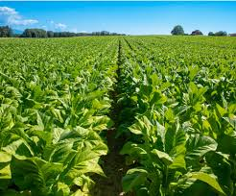
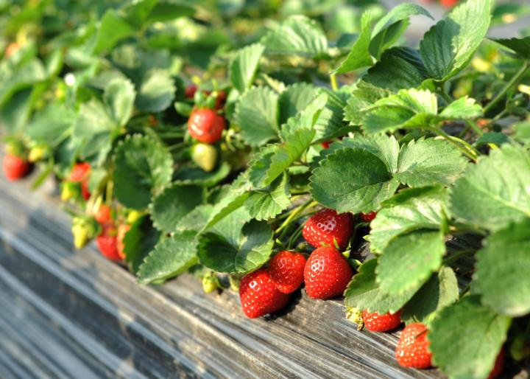
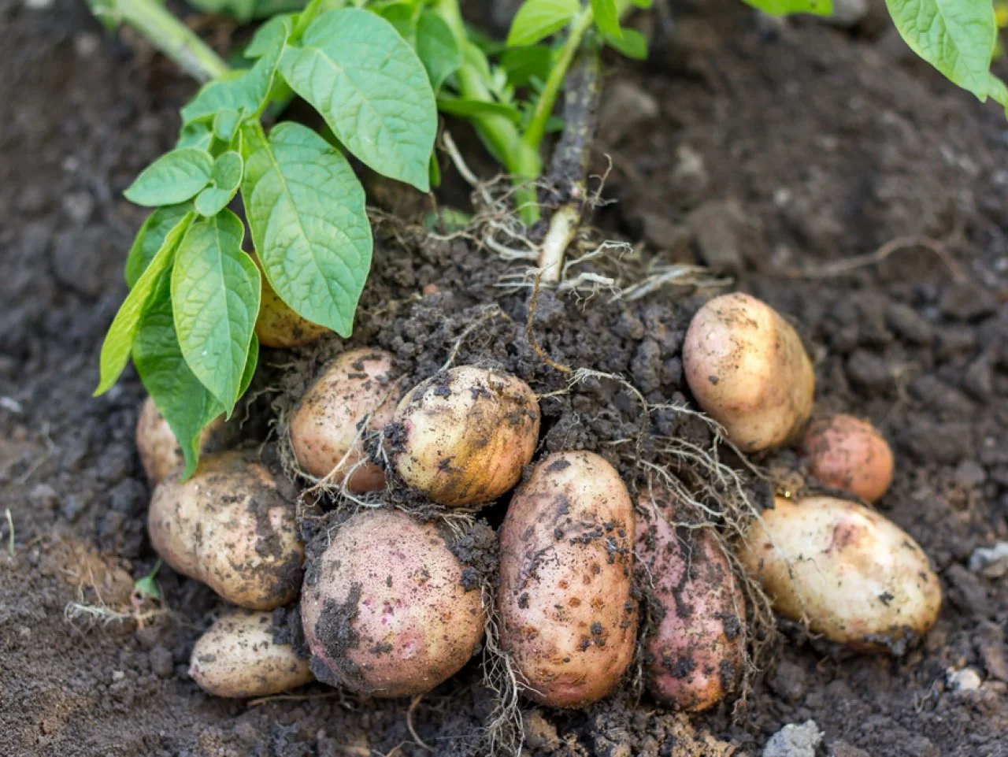
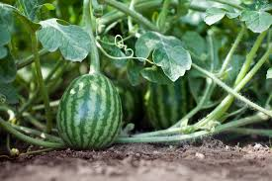
Abstract
This report evaluates the modes of action, efficacy, application timing, combination strategies, and resistance management for azoxystrobin, thiophanate-methyl, and propamocarb. With a focus on crops prevalent in Lebanon, such as strawberries, potatoes, tobacco, and melons, this document synthesizes findings from multiple studies to provide actionable insights. Proper integration of these fungicides into disease management practices can enhance agricultural productivity while reducing the risk of resistance development.

Slide 3
Table of Contents
Introduction
Mode of Action
Efficacy
Individual Fungicides
Combination Treatments
Guidelines for Use
Timing and Target Diseases
Combining Fungicides
Managing Resistance
Examples of Crop Applications in Lebanon
Conclusion
References

Slide 4
Introduction
Fungal and oomycete pathogens pose a significant threat to agriculture in Lebanon, impacting key crops such as strawberries, potatoes, tobacco, and melons. Effective disease management requires the use of reliable fungicides combined with integrated pest management (IPM) practices. This report focuses on three widely used fungicides—azoxystrobin, thiophanate-methyl, and propamocarb—highlighting their application in Lebanon's agricultural context.

Slide 5
Mode of Action These fungicides offer complementary actions that can be used independently or in combination to address a wide range of plant diseases.
Fungicide | Mode of Action | Target Pathogens
Azoxystrobin | Inhibits mitochondrial respiration by binding to the cytochrome bc1 complex, disrupting ATP synthesis. | Fungal pathogens (e.g., rusts, powdery mildew).
Thiophanate-Methyl | Inhibits microtubule polymerization, preventing fungal cell division. | Leaf spots, anthracnose, botrytis.
Propamocarb | Disrupts lipid synthesis and affects cell membrane permeability. | Oomycetes (e.g., Phytophthora, Pythium).

Slide 6
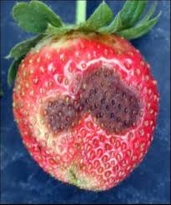
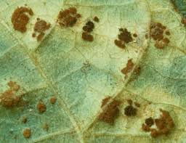
rust on tobacco
powdery mildew on potato
Anthracnose strawberry

Slide 7
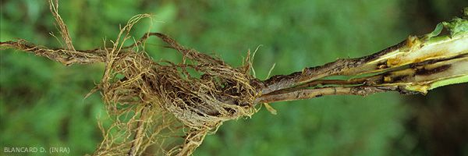
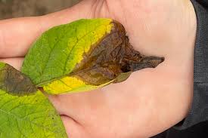
Pythium pathogens of tobacco
Leaf spot on strawberry
botrytis on potato

Slide 8
Efficacy Individual Fungicides
Fungicide | Disease Target | Efficacy (%) | Study Source
Azoxystrobin | Tobacco Brown Spot | 91.1–100 | Plant Disease
Thiophanate-Methyl | Powdery Mildew (Melons) | 80–95 | European Journal of Plant Pathology
Propamocarb | Strawberry Root Rot | 85–90 | Journal of Fungal Biology

Slide 12
Combination Treatments
Combination | Target Disease | Efficacy (%) | Notes
Azoxystrobin + Thiophanate-Methyl | Powdery Mildew (Melons) | 92–96 | Broader spectrum and better resistance management.
Azoxystrobin + Propamocarb | Late Blight (Potatoes) | 90–95 | Effective against fungal and oomycete pathogens.

Slide 13
Guidelines for Use Timing and Target Diseases
Fungicide | Application Timing | Crop Examples in Lebanon | Target Diseases
Azoxystrobin | Preventive and curative | Tobacco, melons | Brown spot, powdery mildew
Thiophanate-Methyl | Early infection stages | Tomatoes, cucumbers | Gray mold, leaf spots
Propamocarb | Pre-plant or soil drench | Strawberries, potatoes | Root rots, late blight

Slide 14
Combining Fungicides
Combining fungicides is recommended to:
Enhance Spectrum of Control: Target multiple fungal and oomycete pathogens by mixing fungicides with different modes of action.
Example: Azoxystrobin + thiophanate-methyl for powdery mildew.
Delay Resistance Development: Use alternation or rotation to prevent the development of resistance.
Example: Alternate azoxystrobin and propamocarb for potatoes.
Address Complex Diseases: Target both foliar and root pathogens simultaneously.
Example: Use azoxystrobin for foliar protection and propamocarb as a soil drench.

Slide 15
Managing Resistance
Rotational Use: Alternate fungicides to reduce selection pressure.
Integrated Practices: Employ crop rotation, resistant varieties, and optimized irrigation.
Monitoring: Regularly assess pathogen sensitivity to adjust fungicide application.

Slide 16
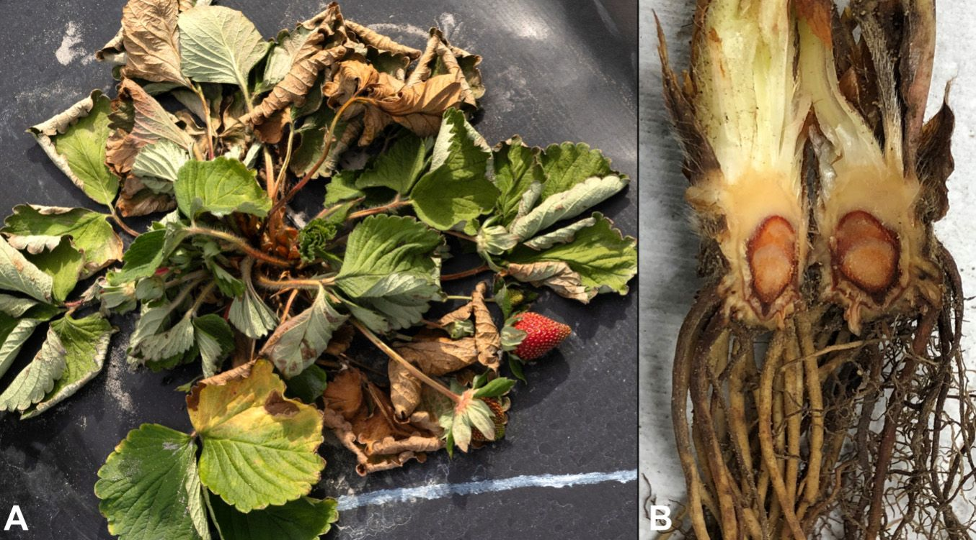
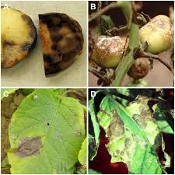
Examples of Crop Applications in Lebanon
Strawberries
Problem: Root rots caused by Pythium and Phytophthora.
Solution:
Propamocarb as a soil drench before planting or during early growth stages.
Combine with azoxystrobin for foliar protection.
Potatoes
Problem: Late blight caused by Phytophthora infestans.
Solution:
Rotate azoxystrobin and propamocarb.
Apply azoxystrobin preventively and propamocarb during high soil moisture.
Phytophthora on strawberries
Phytophthora on Potato

Slide 17
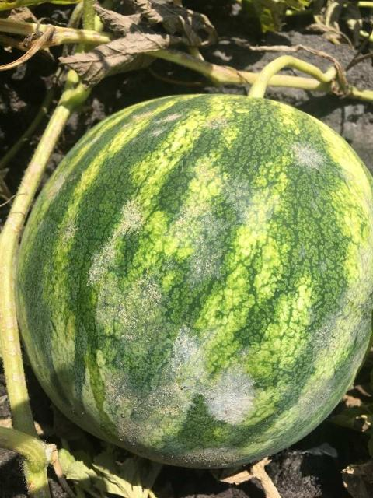
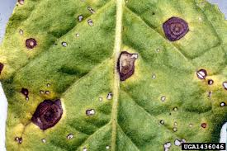
Melons
Problem: Powdery mildew.
Solution:
Use azoxystrobin and thiophanate-methyl together.
Apply azoxystrobin preventively and thiophanate-methyl curatively.
Tobacco
Problem: Brown spot caused by Alternaria alternata.
Solution:
Azoxystrobin as a preventive and curative measure, especially during humid conditions.
Powdery mildew on melons
Brown spot on Tobacco

Slide 18
Conclusion
Azoxystrobin, thiophanate-methyl, and propamocarb are versatile fungicides that, when used strategically, can manage critical plant diseases . Their complementary modes of action provide effective solutions against fungal and oomycete pathogens. By integrating these fungicides with cultural practices, Lebanese farmers can achieve sustainable disease control and enhanced productivity.

Slide 19
References
Plant Disease Journal
European Journal of Plant Pathology
Journal of Fungal Biology
The Pharma Innovation Journal
ScienceDirect

